Slide 1
ADVANCED RETRIEVAL SYSTEM
UNIT: 6

Slide 2
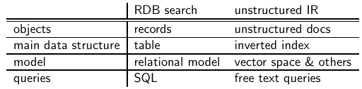
Introduction
IR and relational databases:
IR systems are often contrasted with relational databases (RDB).
Traditionally, IR systems retrieve information from unstructured text (“raw” text without markup).
RDB systems are used for querying relational data: sets of records that have values for predefined attributes such as employee number, title and salary.

Slide 3
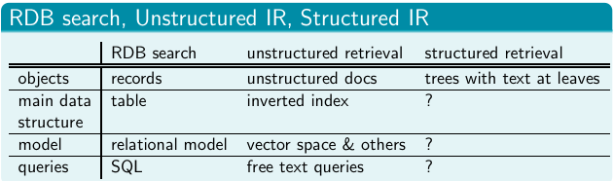
Some structured data sources containing text are best modeled as structured documents rather than relational data (Structured retrieval).
Standard for encoding structured documents: Extensible Markup Language (XML)
structured IR → XML IR
also applicable to other types of markup
(HTML, SGML,. . . )

Slide 4
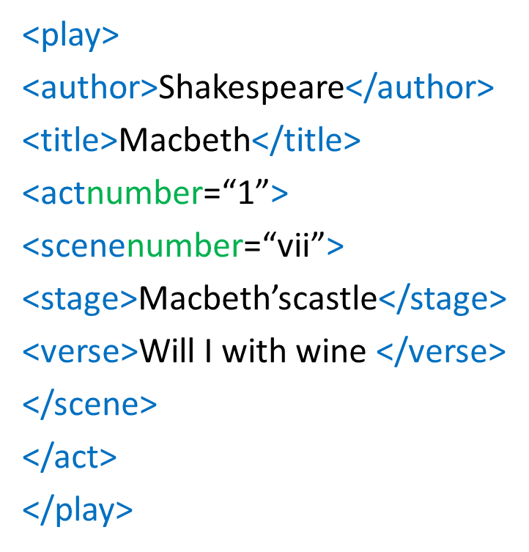
Basic XML concept
XML Document:
Ordered, labeled tree
Each node of the tree is an XML element, with an opening and closing XML tag
(e.g. <title>,</title> )
An element can have one or more XML attributes (e.g. number)
Attributes can have values (e.g. 7)
Attributes can have child elements (e.g. title, verse)

Slide 5
.2XML Document Object Model (XML DOM):
standard for accessing and processing XML documents.
The DOM represents elements, attributes and text within elements as nodes in a tree.
With a DOM API, we can process an XML document by starting at the root element and then descending down the tree from parents to children.
3. XPath:
standard for enumerating paths in an XML document collection.
We will also refer to paths as XML contexts or simply contexts.
4. Schema:
puts constraints on the structure of allowable XML documents.
E.g. a schema for Shakespeare’s plays: scenes can only occur as children of acts.
Two standards for schemas for XML documents are:
1.XMLDTD (document type definition)
2.XML Schema.

Slide 6
Challenges in XML Retrieval
First challenge: document parts to retrieve
Structured or XML retrieval: users want us to return parts of
documents (i.e., XML elements), not entire documents as IR systems usually do in unstructured retrieval.
Example
If we query Shakespeare’s plays for Macbeth’s castle, should we return the scene, the act or the entire play?
In this case, the user is probably looking for the scene.
However, an otherwise unspecified search for Macbeth should return the play of this name, not a subunit.
Solution: structured document retrieval principle

Slide 7
Structured document retrieval principle
One criterion for selecting the most appropriate part of a
document:
A system should always retrieve the most specific part of a document answering the query.
Motivates a retrieval strategy that returns the smallest unit
that contains the information sought, but does not go below
this level.
Hard to implement this principle algorithmically.
E.g. query: title:Macbeth can match both the title of the tragedy,
Macbeth, and the title of Act I, Scene vii, Macbeth’s castle.
But in this case, the title of the tragedy (higher node) is preferred.
Difficult to decide which level of the tree satisfies the query.

Slide 8
Second challenge: document parts to index
Central notion for indexing and ranking in IR: document unit or indexing unit.
In unstructured retrieval, usually straightforward: files on your desktop, email messages, web pages on the web etc.
In structured retrieval, there are four main different approaches to defining the indexing unit.
1 non-overlapping pseudo documents
2 top down
3 bottom up
4 all

Slide 9
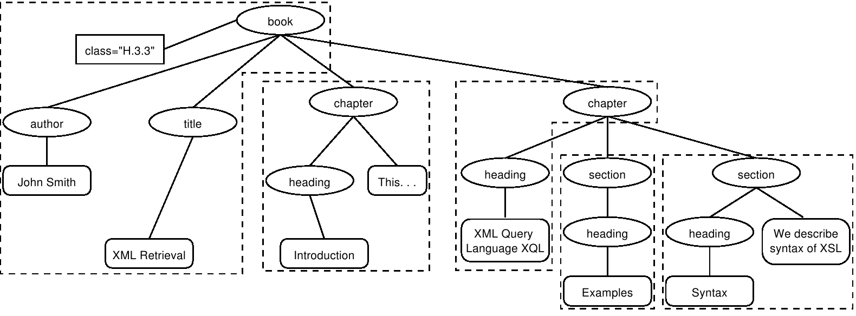
XML indexing unit: approach 1
Group nodes into non-overlapping pseudo documents.
Indexing units: books, chapters, sections, but without overlap.
Disadvantage: pseudo documents may not make sense to the use rbecause they are not coherent units.

Slide 10
XML indexing unit: approach 2
Top down (2-stage process):
Start with one of the latest elements as the indexing unit, e.g. the book element in a collection of books.
Then, post process search results to find for each book the sub element that is the best hit.
This two-stage retrieval process often fails to return the best sub element because the relevance of a whole book is often not a good predictor of the relevance of small sub elements within it.

Slide 11
XML indexing unit: approach 3
Bottom up: Instead of retrieving large units and identifying sub elements (top down), we can search all leaves, select the most relevant ones and then extend them to larger units in post processing. Similar problem as top down: the relevance of a leaf element is often not a good predictor of the relevance of elements it is contained in.

Slide 12
XML indexing unit: approach 4
Index all elements: the least restrictive approach.
Also problematic:
many XML elements are not meaningful search results, e.g., an ISBN number.
indexing all elements means that search results will be highly redundant.
Example:
For the query Macbeth’s castle we would return all of the play,act, scene and title elements on the path between the root node and Macbeth’s castle. The leaf node would then occur 4 times in the result set: 1 directly and 3 as part of other elements.
We call elements that are contained within each other nested elements. Returning redundant nested elements in a list of returned hits is not very user-friendly.

Slide 13
Third challenge: nested elements
Because of the redundancy caused by nested elements it is common to restrict the set of elements eligible for retrieval.
Restriction strategies include:
discard all small elements
discard all element types that users do not look at (working XML retrieval system logs)
discard all element types that assessors generally do not judge to be relevant (if relevance assessments are available)
only keep element types that a system designer or librarian has deemed to be useful search results
In most of these approaches, result sets will still contain nested elements

Slide 14
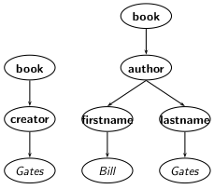
Vector Space Model for XML Retrieval
Aim: to have each dimension of the vector space encode a word together with its position within the XML tree.
How: Map XML documents to lexicalized subtrees.
Take each text node (leaf) and break it into multiple nodes, one for each word. E.g. split Bill Gates into Bill and Gates.
Define the dimensions of the vector space to be lexicalized subtrees of documents – subtrees that contain at least one vocabulary term.

Slide 15
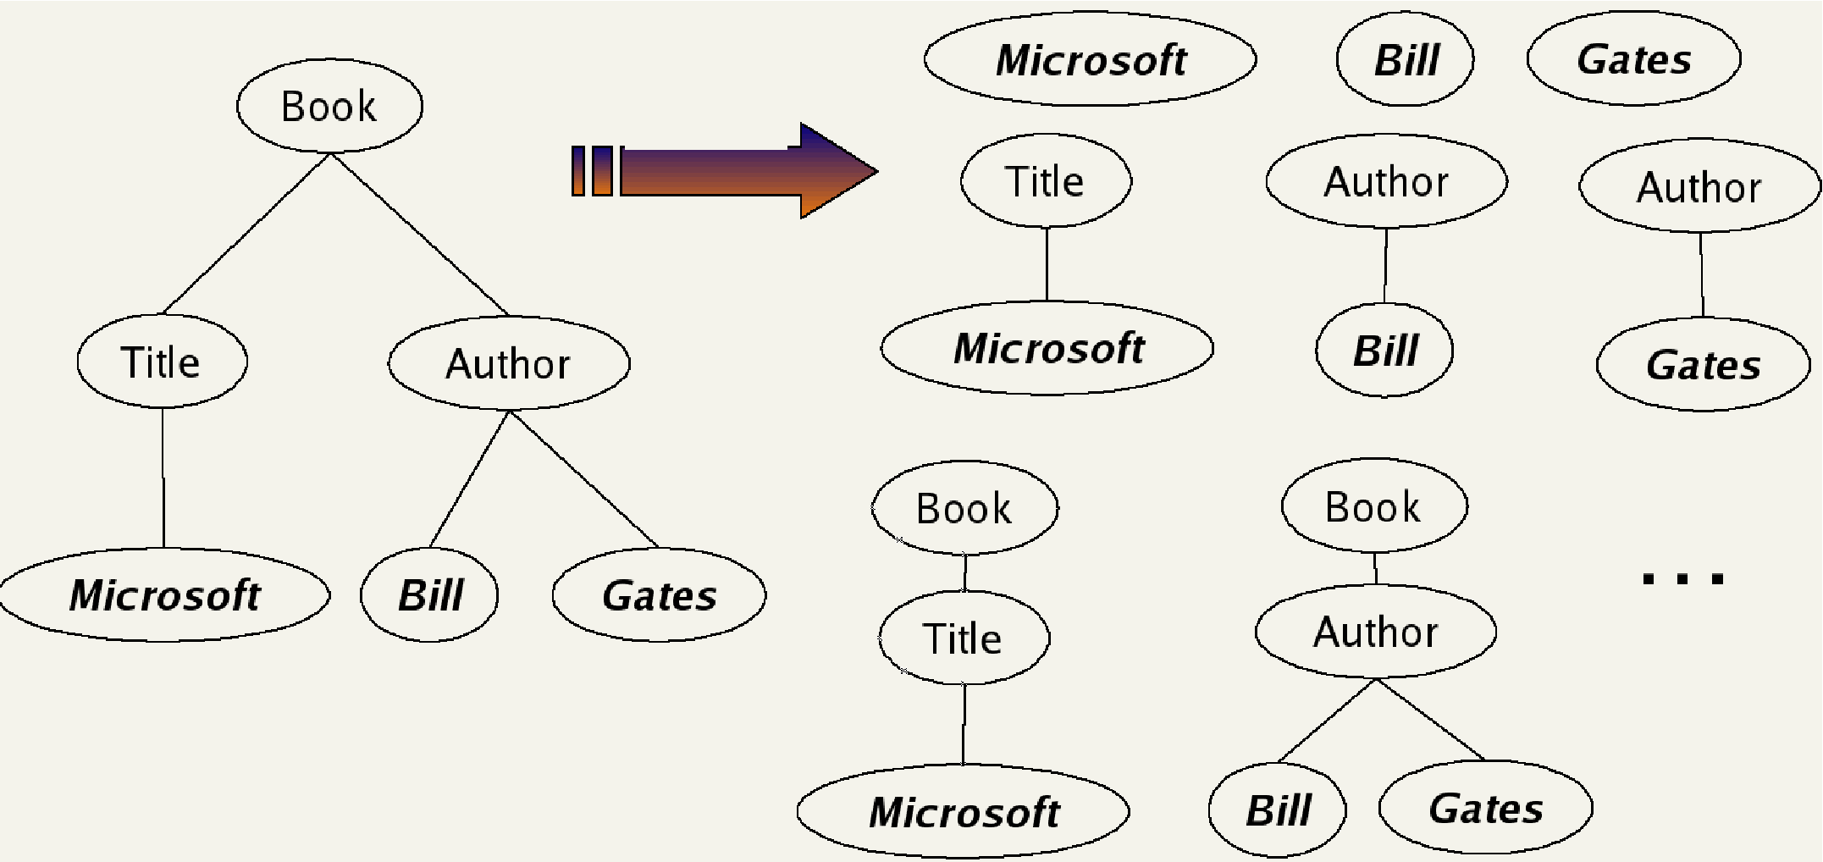
We can now represent queries and documents as vectors in this space of lexicalized subtrees and compute matches between them, e.g. using the vector space formalism.

Slide 16

Context resemblance
A simple measure of the similarity of a path cq in a query and a path cd in a document is the following context resemblance function CR:
|cq | and |cd | are the number of nodes in the query path and document path, resp.
cq matches cd iff we can transform cq into cd by inserting additional nodes.

Slide 17
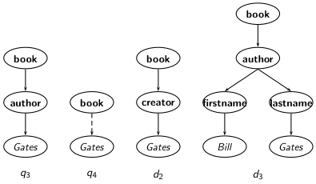
Context resemblance example
Cr(cq4 , cd2) = 3/4 = 0.75. The value of Cr(cq, cd ) is 1.0 if q and d are identical.

Slide 18

Document similarity measure
The final score for a document is computed as a variant of the
cosine measure, which we call SimNoMerge.
SimNoMerge(q, d) =
V is the vocabulary of non-structural terms B is the set of all XML contexts
B is the set of all XML contexts
weight(q, t, c), weight(d, t, c) are the weights of term t in XML context c in query q and document d, resp. (standard weighting e.g. idft · wft,d , where idft depends on which elements we use to compute dft . )
SimNoMerge(q, d) is not a true cosine measure since its value can be larger than 1.0.

Slide 19
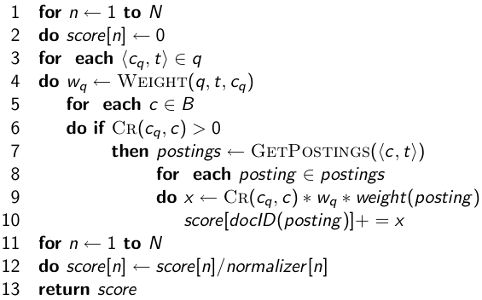
SimNoMerge algorithm
ScoreDocumentsWithSimNoMerge(q,B,V,N, normalizer )

Slide 20
Evaluation of XML Retrieval
Initiative for the Evaluation of XML Retrieval (INEX)
INEX: standard benchmark evaluation (yearly) that has produced test collections (documents, sets of queries, and relevance judgments).
Based on IEEE journal collection (since 2006 INEX uses the much larger English Wikipedia as a test collection).
The relevance of documents is judged by human assessors.

Slide 21
Two types:
content-only or CO topics: regular keyword queries as in unstructured information retrieval.
content-and-structure or CAS topics: have structural constraints in addition to keywords.
Since CAS queries have both structural and content criteria,
Relevance assessments are more complicated than in unstructured retrieval.

Slide 22
INEX 2002 defined component coverage and topical relevance as orthogonal dimensions of relevance
We distinguish four cases:
Exact coverage (E): The information sought is the main topic of the component and the component is a meaningful unit of information.
2 Too small (S): The information sought is the main topic of the component, but the component is not a meaningful (self-contained) unit of information.
3 Too large (L): The information sought is present in the component, but is not the main topic.
4 No coverage (N): The information sought is not a topic of the component.
Component coverage
Evaluates whether the element retrieved is “structurally” correct, i.e., neither too low nor too high in the tree.

Slide 23
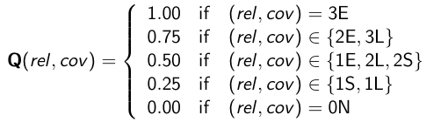

INEX relevance assessments
The topical relevance dimension also has four levels: highly relevant (3), fairly relevant (2), marginally relevant (1) and non relevant (0).
The relevance-coverage combinations are quantized as follows:
The number of relevant components in a retrieved set A of components can then be computed as:

Slide 24
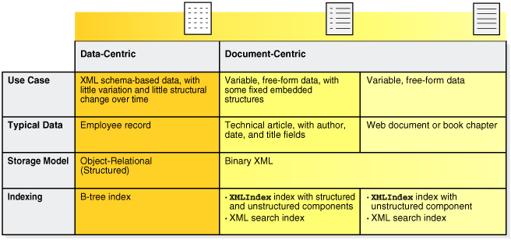
Text-centric vs. data-centric XML retrieval

